Slide 1

Medical Alert System
Shishir Regmi
Inusha Pandey

Slide 2
Scenario
Old methods still prevailing in medical sectors in case of Nepal.
Doctors and nurses may not be always available.

Slide 3
Main Aim
Avoidance of loss of life
Fast and reliable health service
Security

Slide 4
Optional Features
Pulse Tracking
Predicting Emergency Scenario
Medicine Tracking
Sleep Tracking

Slide 5
Algorithms
Open CV and Convolutional Neural Networks based open eye detection
Sensor based movement detection

Slide 6
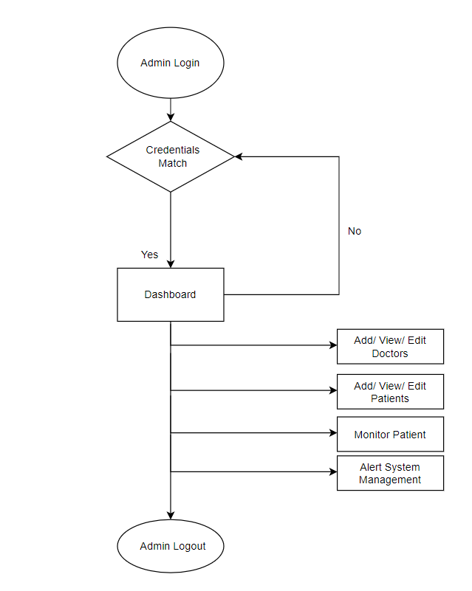
System Flow

Slide 7
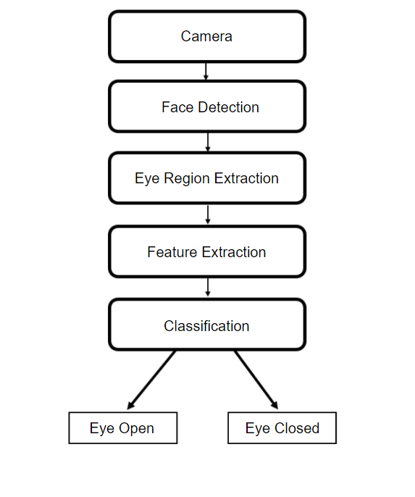
Methodology (Open eye Detection)

Slide 8
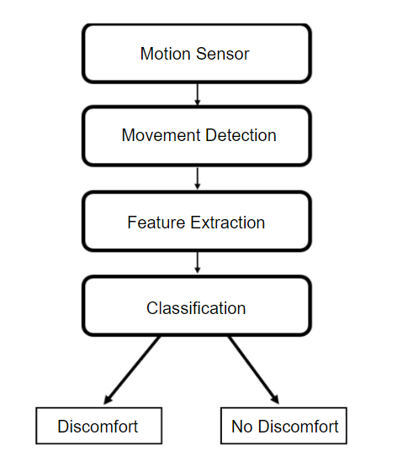
Methodology (Discomfort Detection)

Slide 9
ICT Tools Used
Camera
PIR Motion Sensor
Arduino

Slide 10
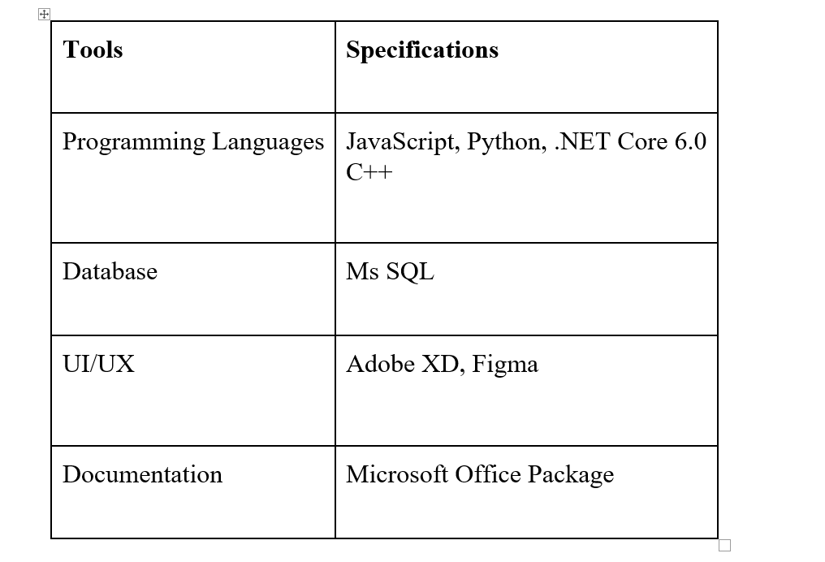

Slide 11
Progress Done
System Design
60% complete
Database Design done
Basics complete
Eye open detection
Training done
Evaluation Ongoing
Motion Detection
Arduino code done
Sensor Implementation Left

Slide 12
ANY QUESTIONS ?

